Slide 1
CoPatE: A Novel Contrastive Learning Framwork for Patent Embeddings
Huahang Li, Shuangyin Li, Yuncheng Jiang, Ganshen Zhao
School of Computer Science,
South China Normal University
Sept 14, 2022

Slide 2
Overview
Background
Methodology
Experiments
Conclusions

Slide 3

Background
Notes:
That is, the technologist needs to identify the keywords of the target technology, make a query and then retrieve the patent set from the database

Slide 4
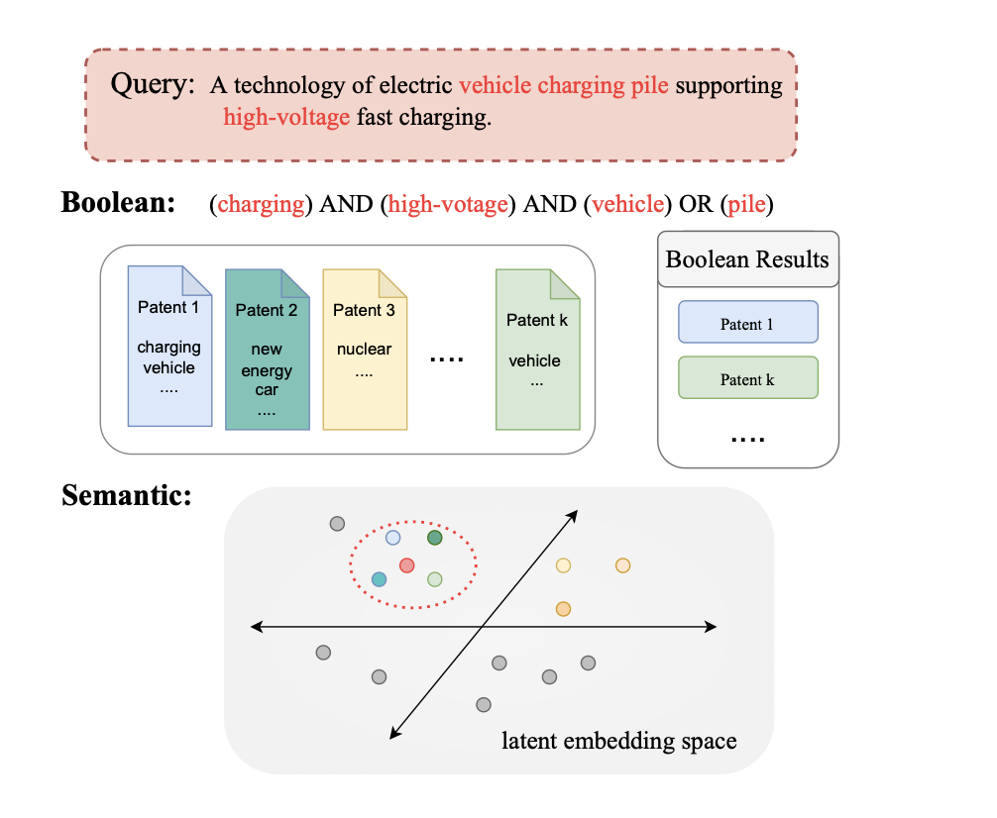
Background
The limitation of Boolean Search
For the query in this example, patent II is about new energy cars but is not retrieved, due to the non-existence of keywords.
Figure 1: Boolean & Semantic Search
Notes:
With the increasing number of patent applications filed each year, managing and exploring patent documents efficiently becomes more and more important. In the past, the methods of patent management and retrieval were based on the traditional database and Boolean search.
That is, the technologist needs to identify the keywords of the target technology, make a query and then retrieve the patent set from the database.

Slide 5
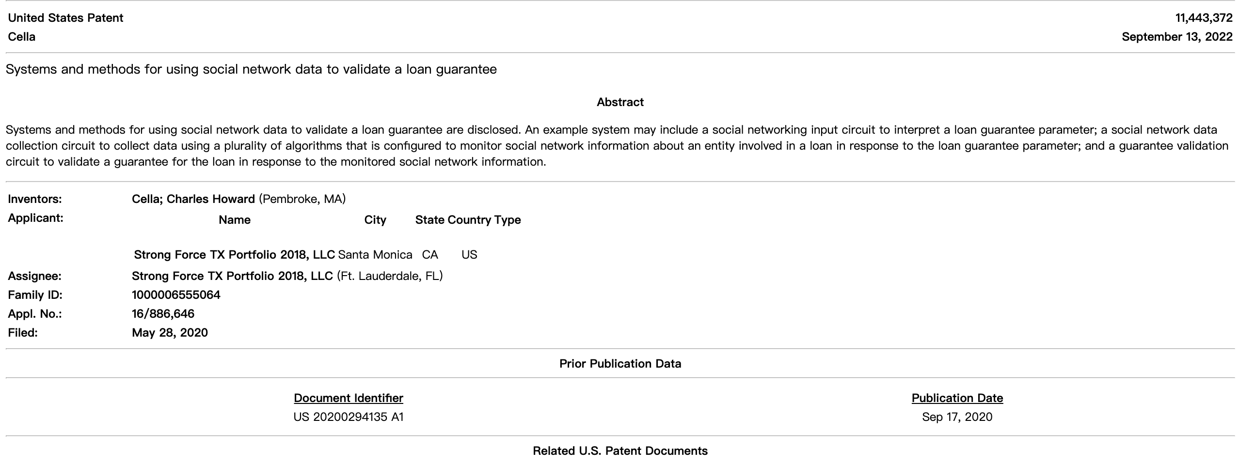
Data Previews
Patent documents follow a standardized structure and consist of typical elements: the unstructured textual, such as title, abstract, description, and claims; the structured tags, such as applicant, classification, region, and so on.

Slide 6
Problems to solve
As we metioned above, how to take full advantage of the semi-structured nature of patents?
how to solve the lengthiness of patents?

Slide 7
Our Contributions
We propose CoPatE: a novel framework of Contrastive Learning for Patent Embeddings, where a patent semantic compression and a tag auxiliary learning modules are well-designed to handle the claims and the tags of the patents. And it is capable of discovering the latent semantics of the complex semi-structured patents.
Supervised contrastive learning is resorted to optimize the embeddings of the patents with CoPatE, where a tailored loss function is presented to fully utilize the hierarchical categories of the patents by dynamic generating of positive and negative samples.

Slide 8
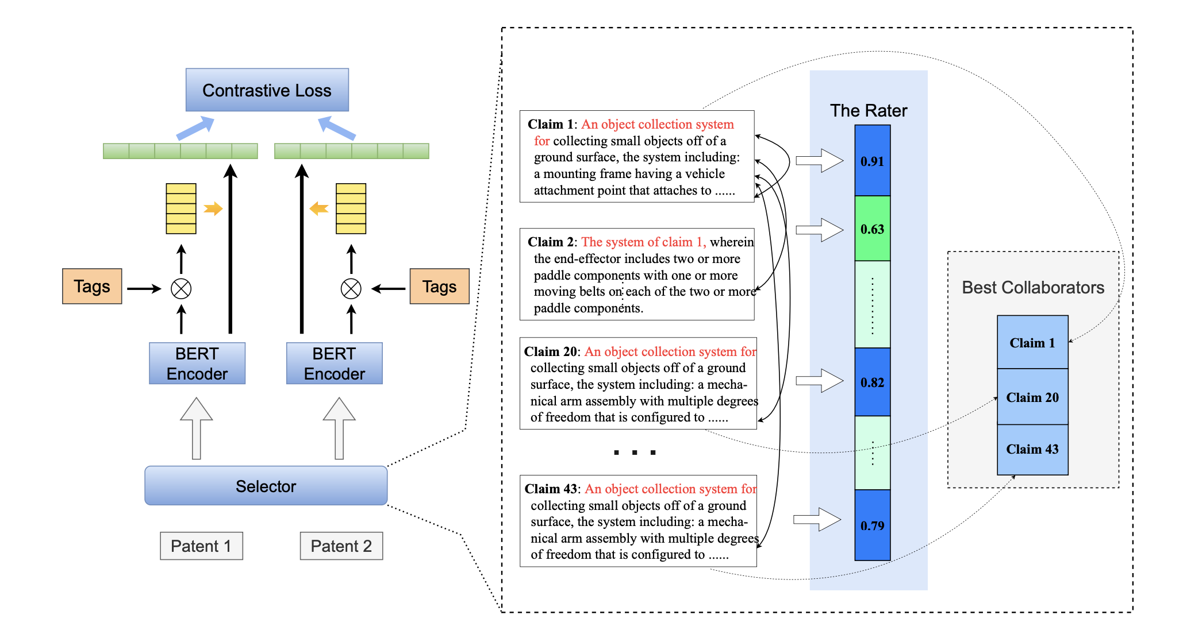
Methodolody
Figure 2: The architecture and work-flow of the CoPatE.
Notes:
The overall architecture of CoPatE is shown in Figure~\ref{CoPatE}. It starts with the patent semantic compression module to reduce the computational costs caused by length, which extracts some informative claims

Slide 9
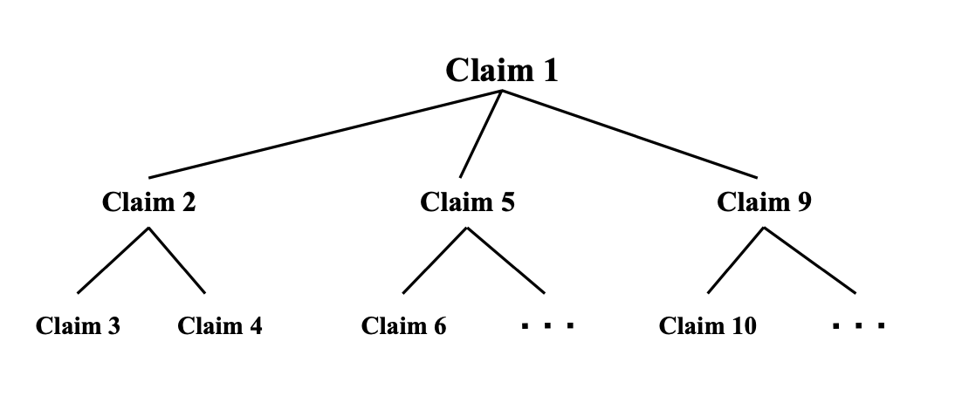
Patent Semantic Compression
Figure 3: Tree hierarchy of the claims.

Slide 10
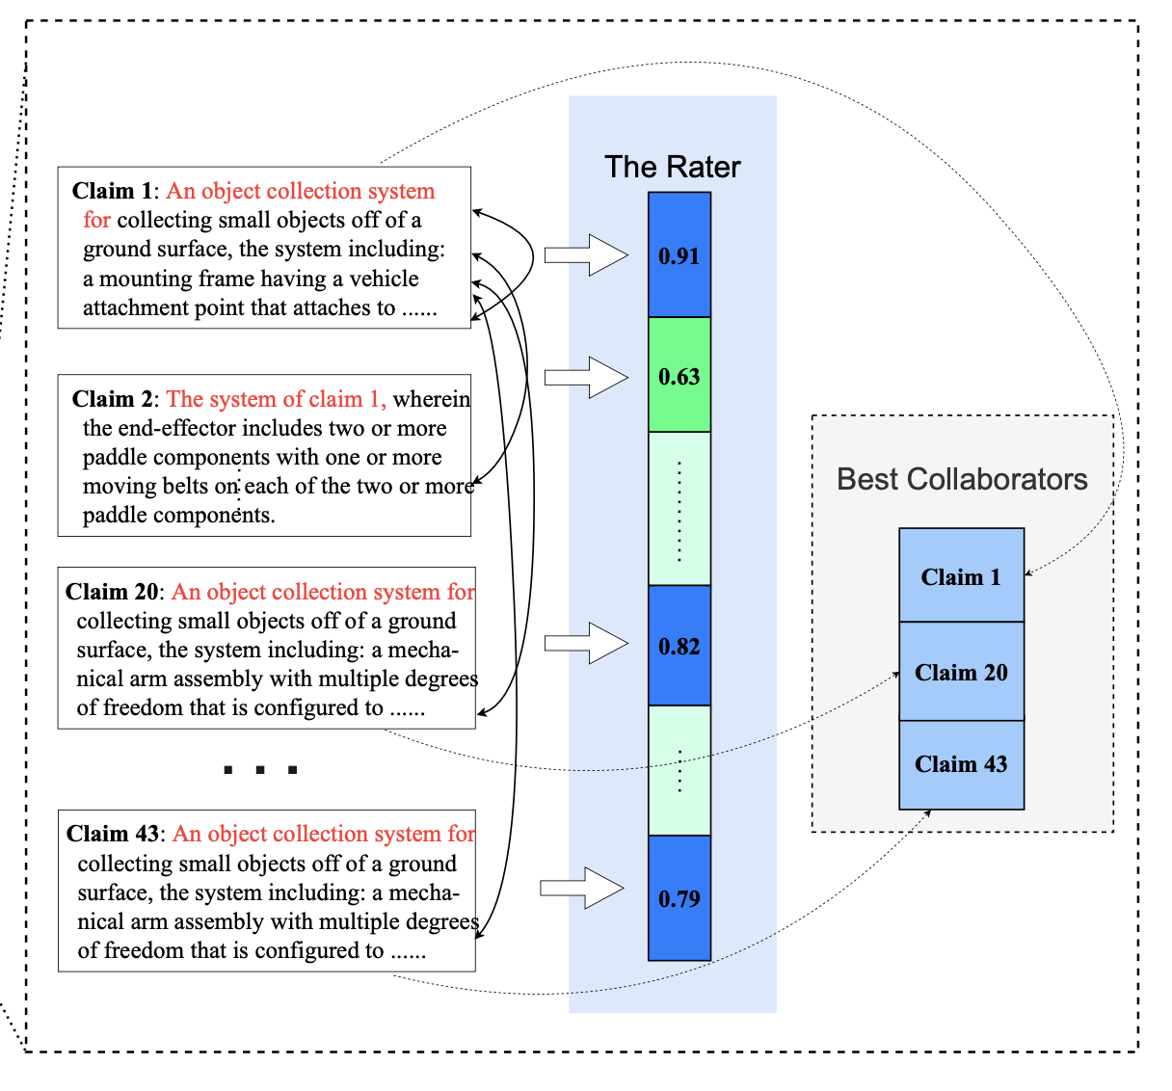
Patent Semantic Compression
Naturally, the claims contain different semantics with different weights for one patent, and the task of patent semantic compression is to select the most representative claims. In our paper, we consider it to be a Knapsack problem.
Notes:
The overall architecture of CoPatE is shown in Figure~\ref{CoPatE}. It starts with the patent semantic compression module to reduce the computational costs caused by length, which extracts some informative claims

Slide 11
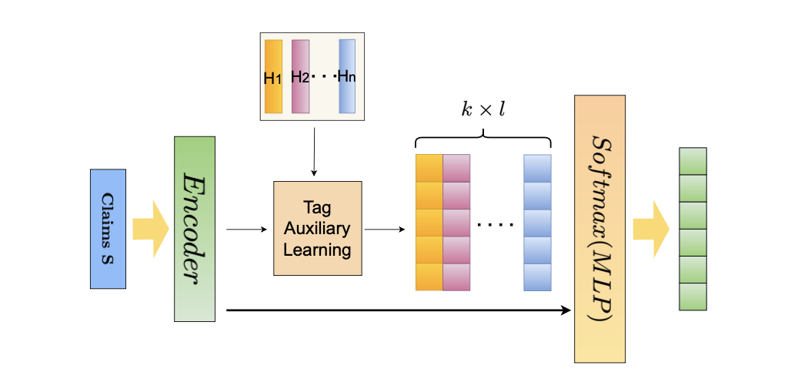
Tags Auxiliary Learning
The architecture of proposed tags auxiliary learn_x0002_ing to fuse tags semantic to text.

Slide 12
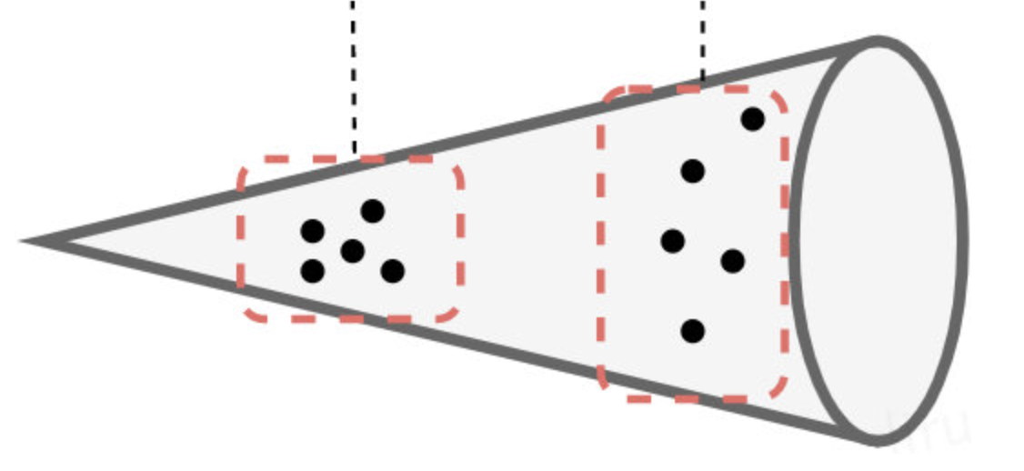
Contrastive Learning
Technically, the sentence embeddings generated from BERT without fine-tuning are inferior in terms of semantic textual similarity.
High Frequency
Low Frequency

Slide 13
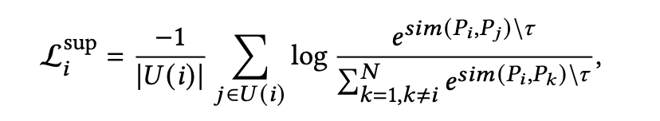
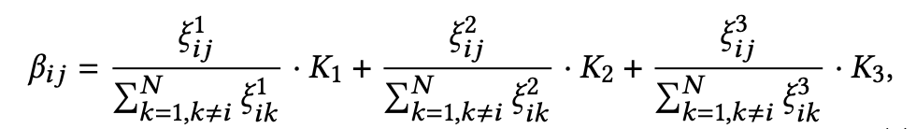
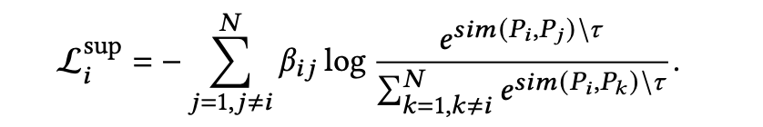
Contrastive Learning
General Loss function:
(1)
Coefficient:
(2)
Our Loss function:
(3)

Slide 14
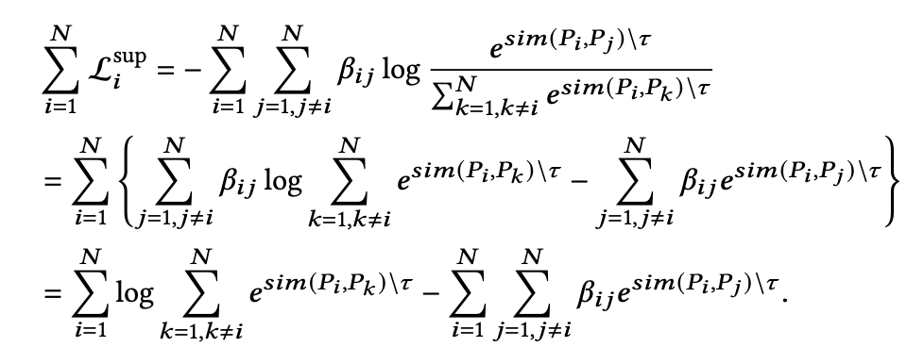
Contrastive Learning
To elaborated our loss function in a detailed way:
(4)

Slide 15
Experiments
Data
We used the patent application data released by USPTO and selected 2,040,320 patents in total from 2013 to 2020 as our training set.
5,000 patents randomly selected from 298,559 patents in 2021 are used as our test set.

Slide 16
Experiments
Setups
Learning Rate | 1.0*10⁻⁴ | t_{up} & t_{down} | 0.2 & 0.05
Warm up steps | 1/10*total steps | K₁ | 0.2
batch size | 32 | K₂ | 0.3
temperature | 0.1 | K₃ | 0.5
We trained CoPatE on dual Tesla A40s with 96GB GPU memory in total, and tested on the validation set every 5000 steps to pick the best performing model.

Slide 17
Tasks & Metrics
Patent Retrieval:
  Sentences from the title and the abstract of a patent are used as the query for this patent in the retrieval task, with an average length of 30 tokens. And patents in the same categories (subclass level in the CPC scheme ) are should be retrieved.
  Patent Classification:
  Equally, we perform the classification task at the subclass level for a total of 664 categories and the official category descriptions from USPTO are used as the tags.

Slide 18
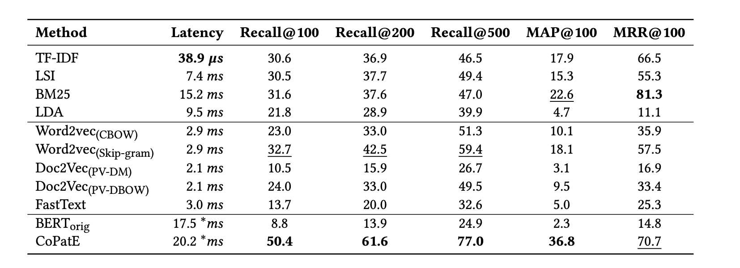
Results: Patent Retrieval
Retrieval performance (in percent) and query latency of various information retrieval approaches on the test set. The best results are marked in bold, and the second-best results are underlined. Note that the inference time for the deep learning method is on the GPU, while the other methods are on the CPU.

Slide 19

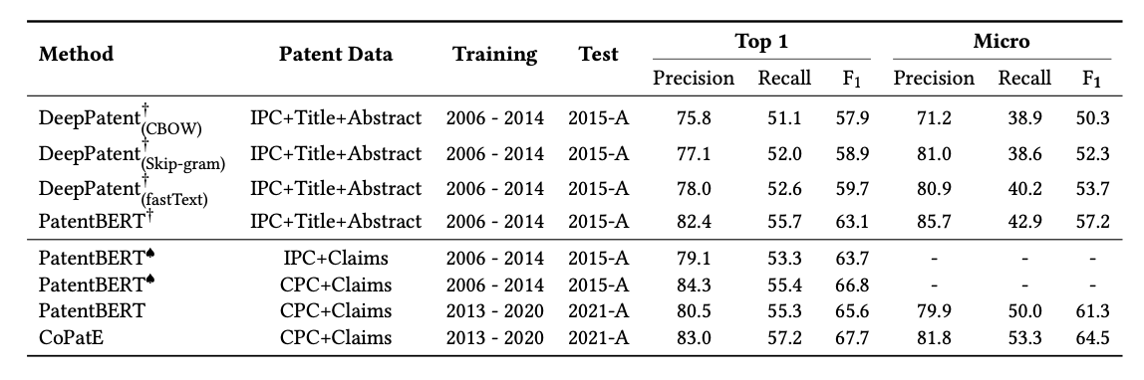
Results: Patent Classification
Shows the results (in percent) on patent classification. : results from Roudsari et al. at PatentNet, where only 544 labels at IPC subclass level. : results from Lee et al. PatentBERT, where 632 labels at IPC subclass level and 656 labels at CPC subclass level. Both of them evaluated on a same test set 2015-A.

Slide 20
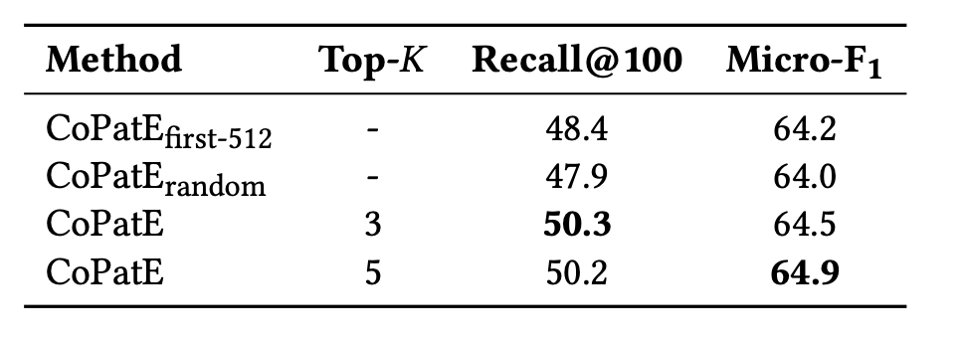
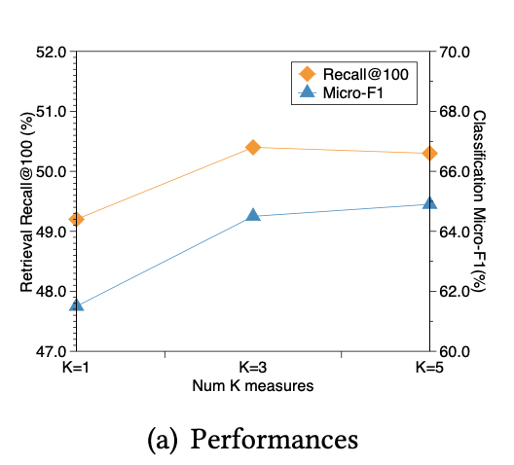
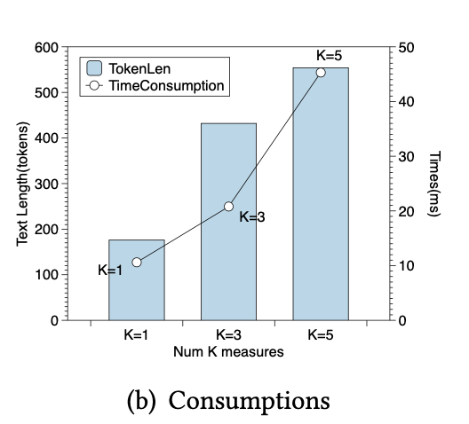
Ablation Studies
Patent Semantic Compression

Slide 21
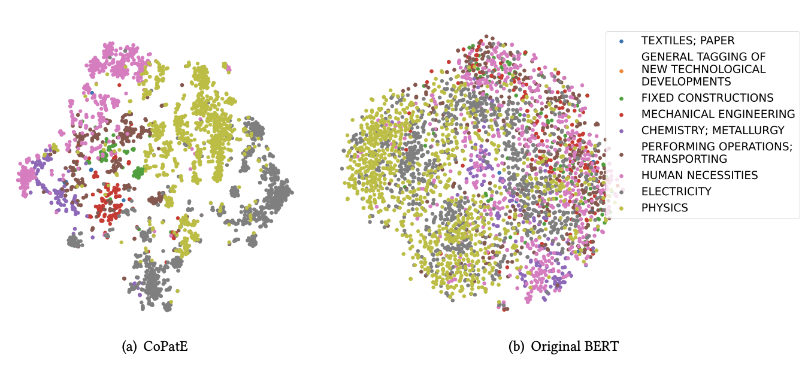
Ablation Studies
Contrastive Learning

Slide 22
Future work
The future works include how to make use of the other unstructured texts, such as titles, abstracts, and descriptions, and the structured information, such as the correlations among the claims.

Slide 23
Thanks for your listening!

